Slide 1

Order and Sales Analysis on Amazing Mart :
by: Shiny Francis Yash Ghanwate

Slide 2

Introduction :
Welcome to our sales analysis presentation. Our goal is to derive actionable insights from our sales data to inform strategic decisions and enhance business performance. We'll explore trends, customer behavior, product performance, regional sales, shipping efficiency, and profitability.
Key areas of focus include:
Order Distribution: Analyzing sales by country, region, city, and state to identify key markets.
Customer Segmentation: Understanding purchasing patterns across different market segments and demographics.
Product Analysis: Identifying top-selling and underperforming products to optimize inventory and promotions.
Shipping and Delivery: Evaluating shipping methods and delivery times to improve logistics.
Financial Performance: Assessing revenue, profit margins, and the impact of discounts.

Slide 3

Objectives :
The primary objectives of our sales analysis are to gain deep insights into our sales operations and drive strategic decisions. We aim to:
Identify Sales Trends: Understand seasonal patterns and sales fluctuations over time.
Analyze Customer Behavior: Examine purchasing patterns, preferences, and demographics to tailor our marketing efforts.
Evaluate Product Performance: Determine which products are top-sellers and which need improvement or discontinuation.
Assess Regional Performance: Identify high-performing and underperforming regions to allocate resources effectively.
Optimize Shipping and Delivery: Analyze shipping methods and delivery times to improve logistics and customer satisfaction.
Maximize Profitability: Explore opportunities to enhance profit margins through pricing strategies, discount management, and cost control.

Slide 4
Content :
Sql :
Python :
Excel :
Power BI :
Tableau :

Slide 5

SQL objective and solutions :

Slide 6
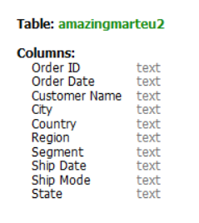
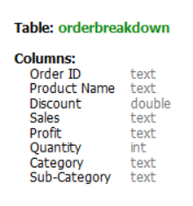
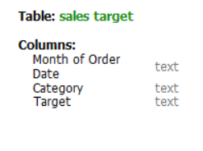
Dataset :
Amazing Mart Sales Data :

Slide 7
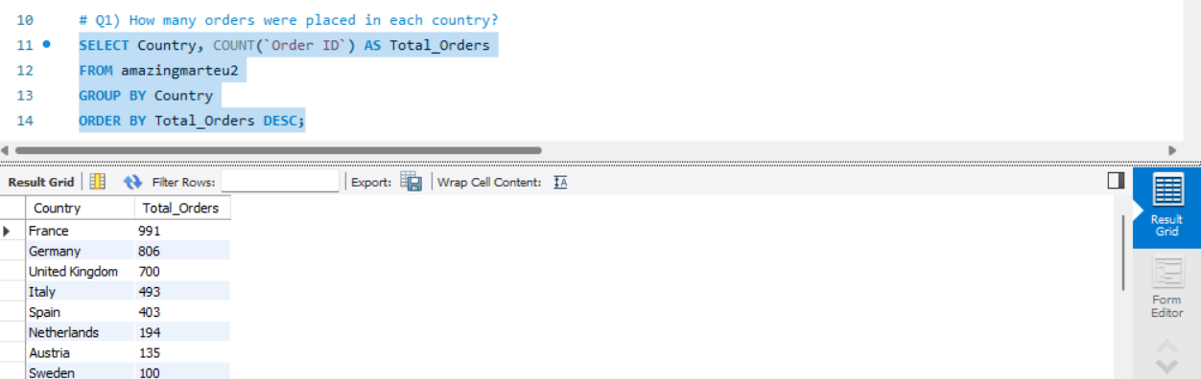
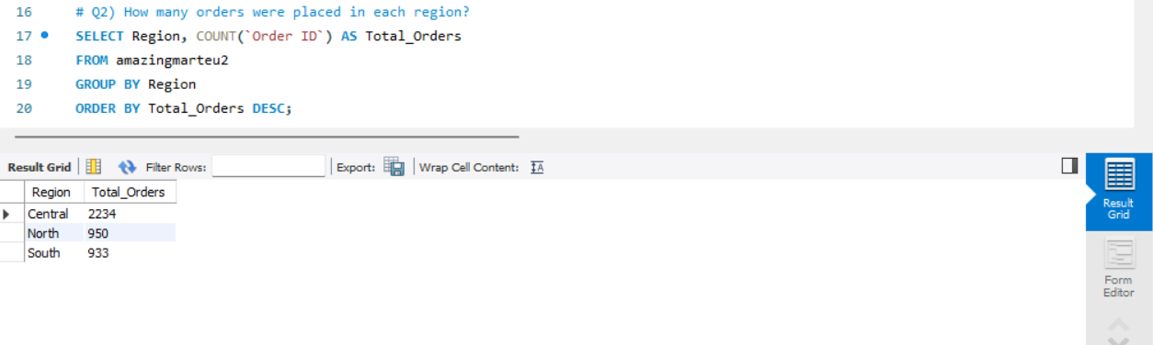

Slide 8
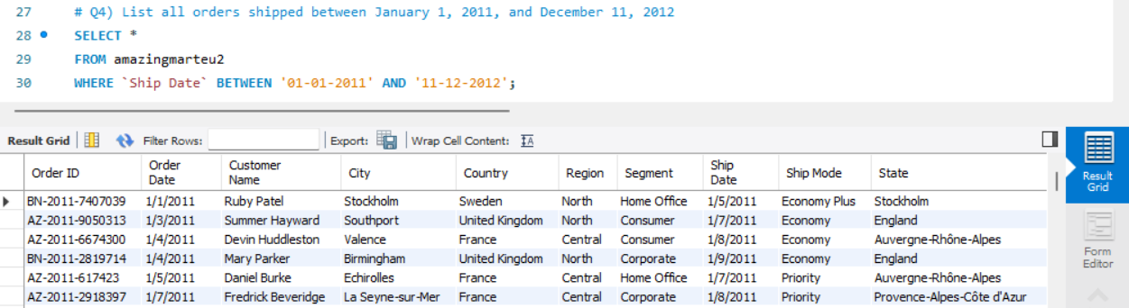
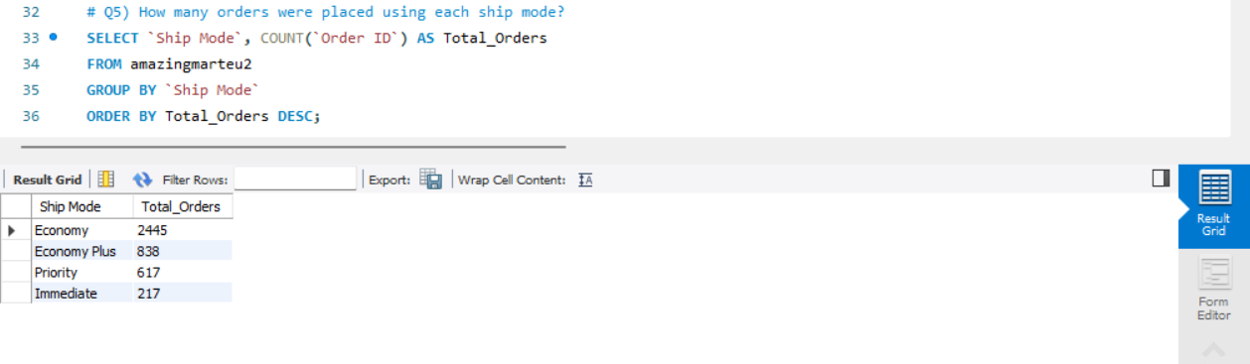

Slide 9
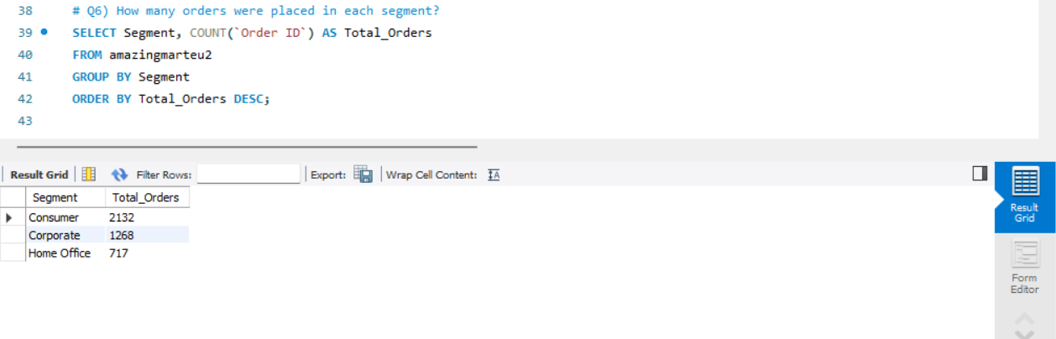
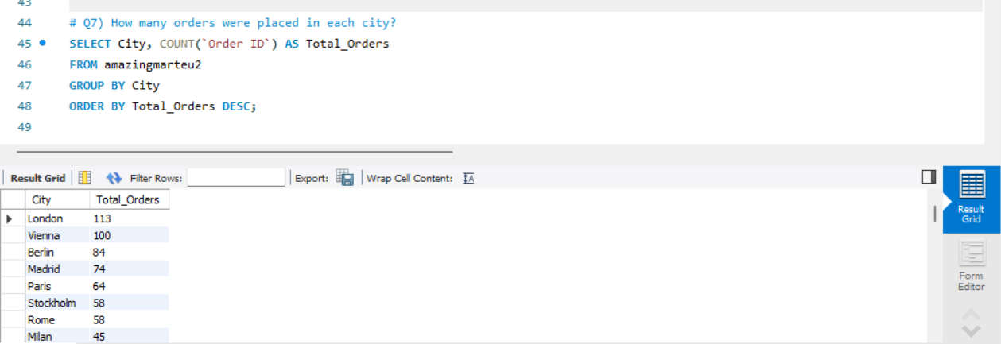

Slide 10
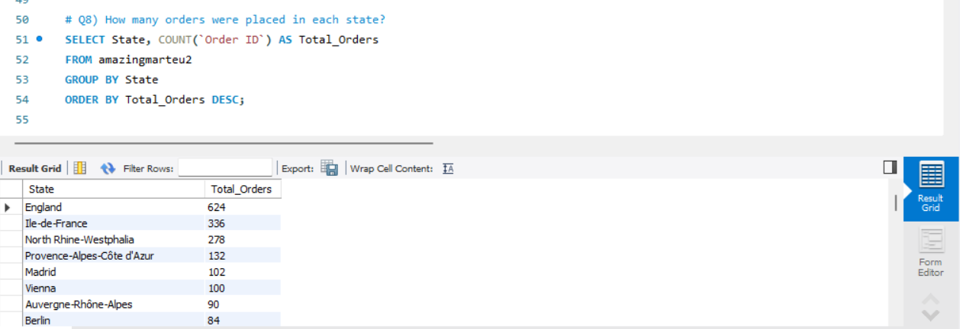
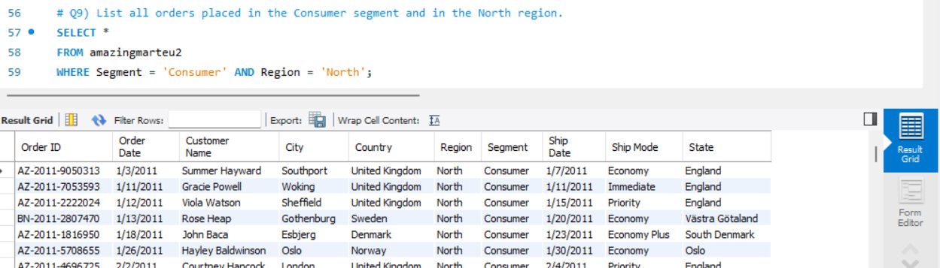

Slide 11
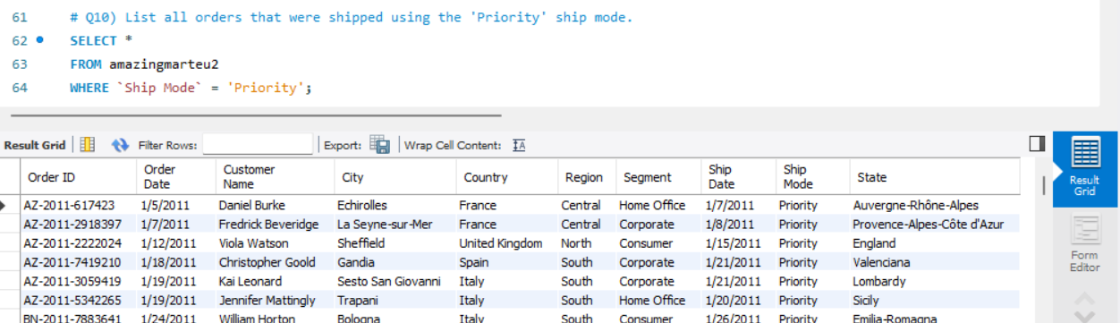
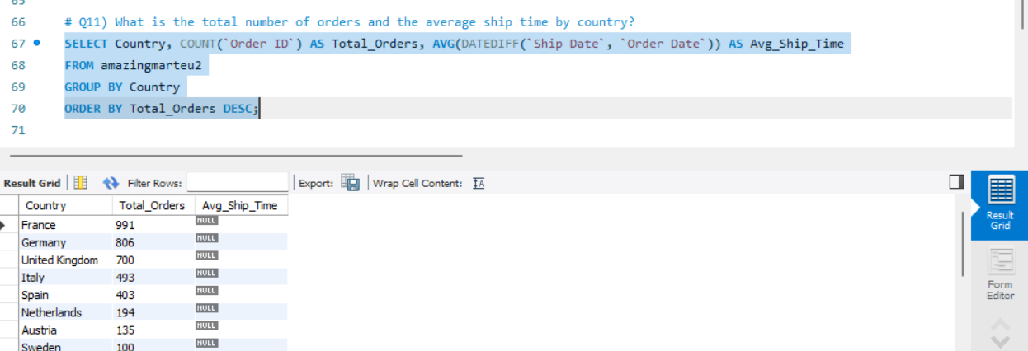

Slide 12
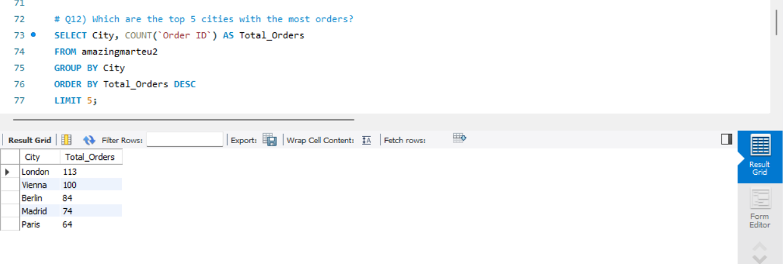
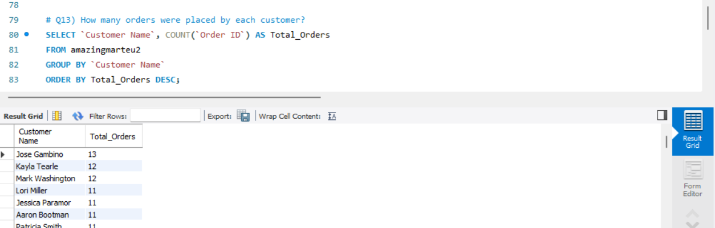

Slide 13
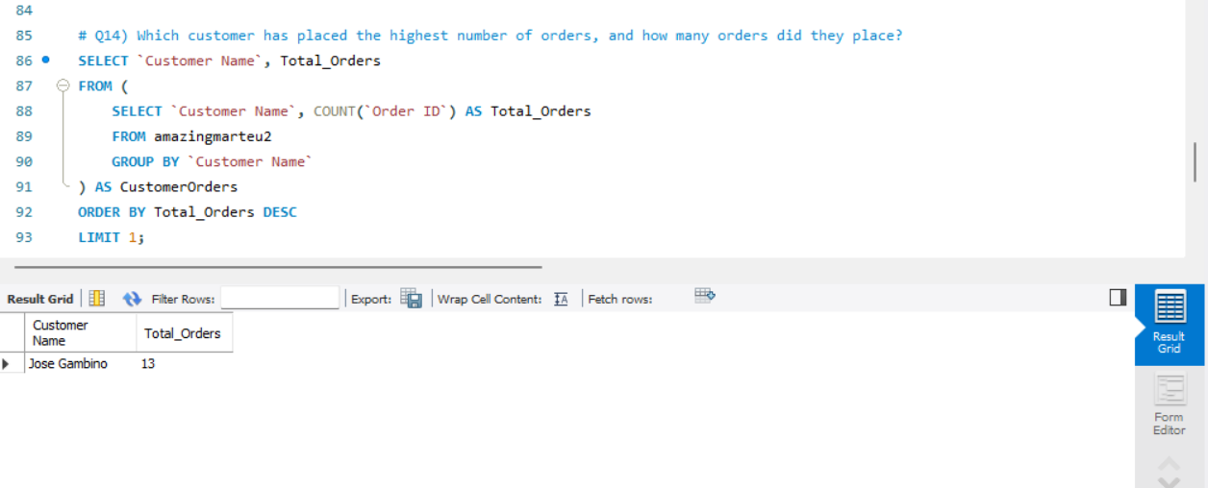
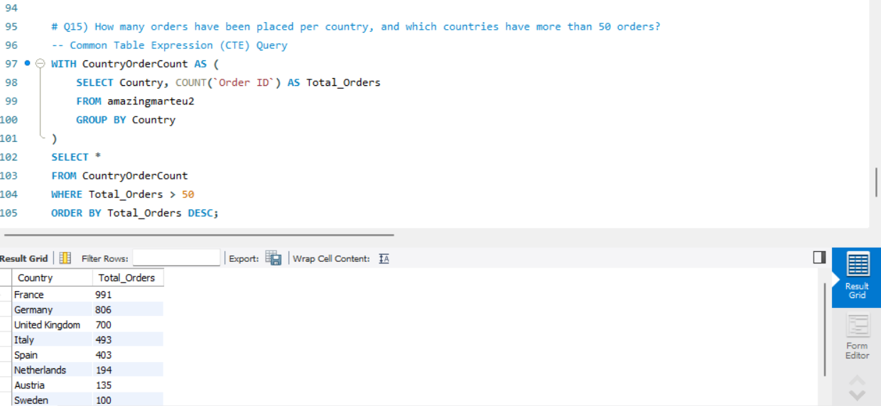

Slide 14
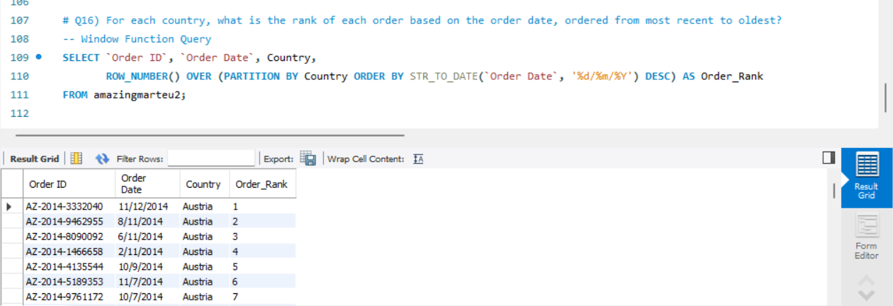
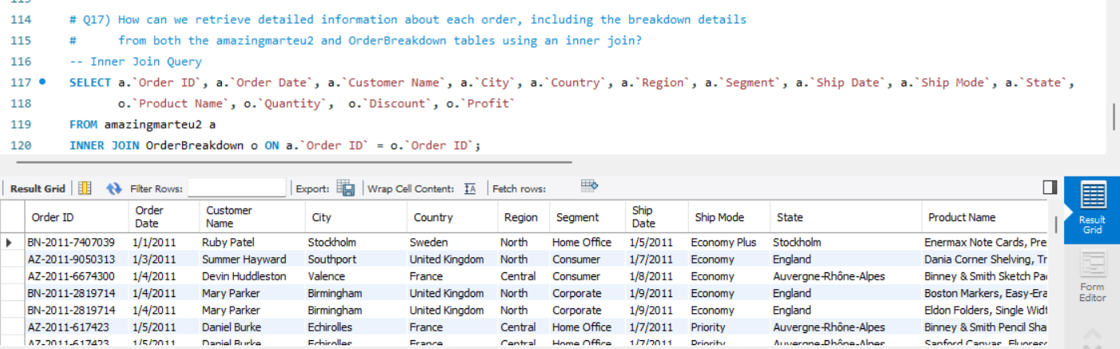

Slide 15
Exploratory data analysis

Slide 16
Insights from the Dataset
Data Loading:
Loading data from various sources such as xlsx files, Excel sheets, or databases.
Checking Structure of Data:
Examining the dimensions and structure of the dataset using methods like .head() which returns first few columns of the dataset or .info() which can show datatypes or .shape() to get the dimensions of the data or describe() which can generate descriptive statistics of the data.

Slide 17
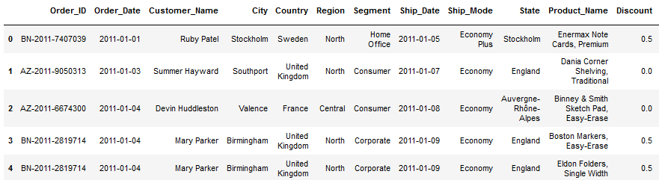
DATA set

Slide 18
Pre Processing and Data Cleaning
Renaming of variables: Renamed the variables as per naming convention. Renaming of variables: Renamed the variables as per naming convention.
Duplicates Value: We searched for duplicates value but there were duplicates in dataset.
Handling Missing Values: Identify and handle missing values in dataset.
Convert column to appropriate data type: Converted object variables to float object
Outlier Detection: Outliers are not treated because they are numerous and appear to be accurate as per manual observation. Removing the outliers will negatively impact the overall data analysis.

Slide 19
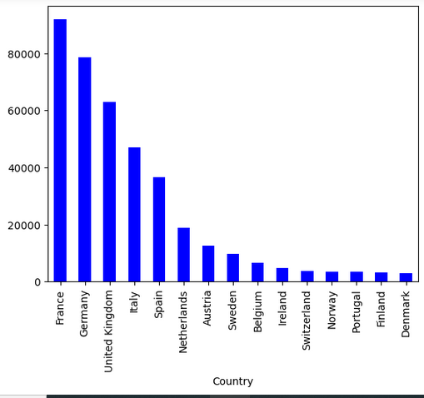
Value counts of Country

Slide 20
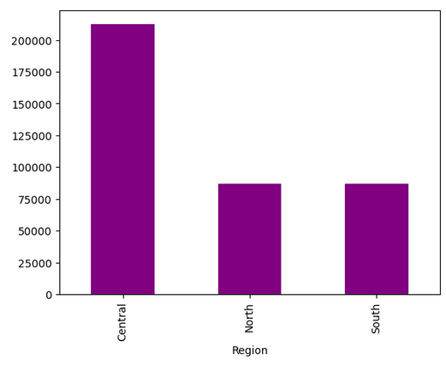
Value counts of Region

Slide 21
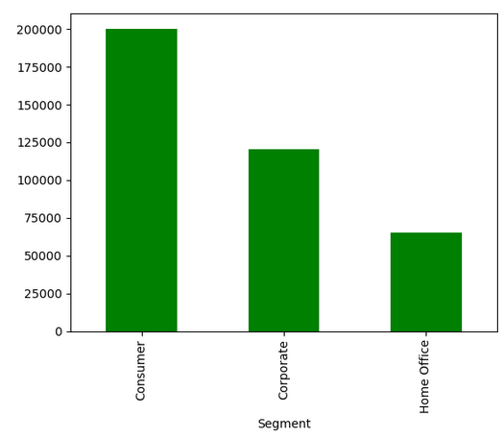
Value counts of Segment

Slide 22
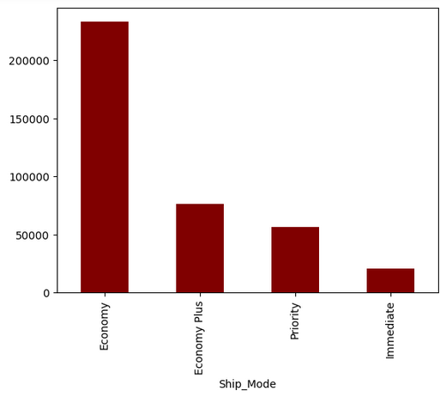
Value counts of Ship_Mode

Slide 23
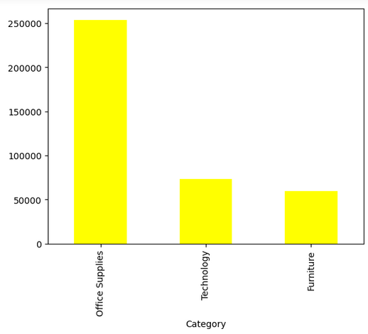
Value counts of Category

Slide 24
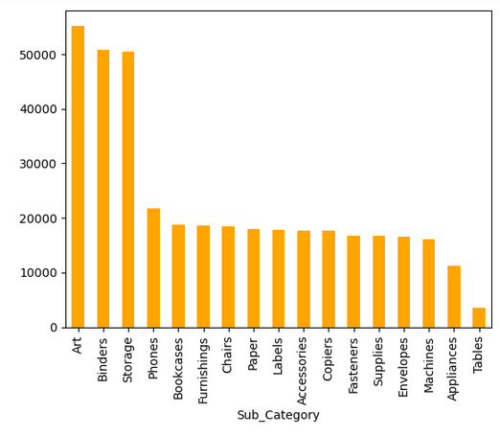
Value count of Sub_Category

Slide 25
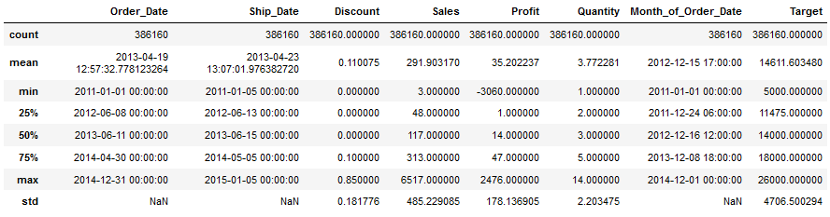
Observing a single column for the outliers

Slide 26
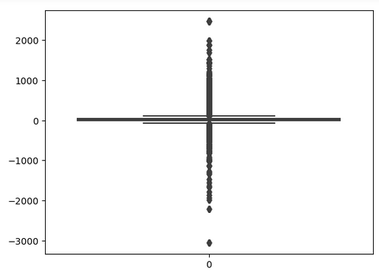
Profits from the product

Slide 27
Power BI Dashboard
Overview:
The Power BI dashboard offers a comprehensive, interactive view of our sales data, facilitating real-time insights
and detailed analysis.
Key Features:
Interactive Visualizations: Dynamic charts, graphs, and tables that update based on user interactions, such
as filtering and slicing.
Drill-Down Capability: Enables users to explore specific data points in greater detail.
Main Sections:
Sales Performance: Displays total sales, sales trends, and comparisons over different time periods.
Customer Insights: Analyzes customer demographics, identifies top customers, and examines purchasing
patterns.
Product Analysis: Highlights best-selling products and their profitability.
Regional Sales: Visualizes sales distribution by region and includes performance heatmaps.
Shipping and Logistics: Evaluates shipping methods and tracks delivery times for efficiency.
Customization:
Users can tailor the dashboard to their specific needs, enabling personalized analysis and reporting.
Real-Time Data:
Connected to live data sources, the dashboard ensures up-to-date and accurate information for decision-making.

Slide 28
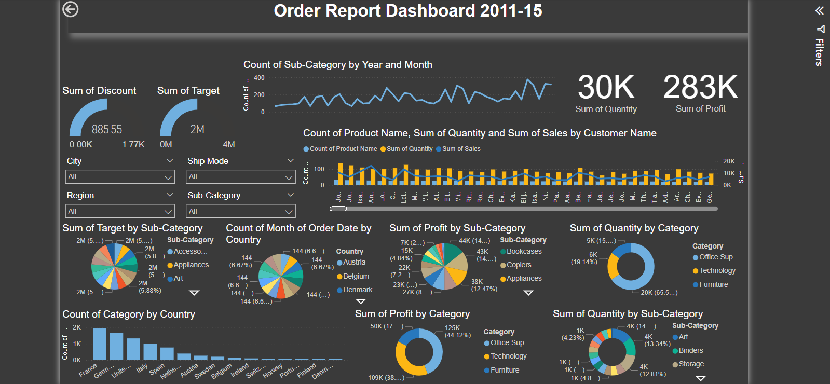

Slide 29
Tableau :
Overview:
The Tableau dashboard offers a dynamic and interactive visualization of our sales data, enabling real-time insights
and in-depth analysis.
Key Features:
Interactive Visualizations: Includes responsive charts, graphs, and tables that update with user interactions like
filtering and drilling down.
User-Friendly Interface: Simplifies data exploration and analysis with an intuitive design.
Main Sections:
Sales Performance: Displays total sales, trends over time, and period comparisons.
Customer Insights: Analyzes demographics, identifies top customers, and examines purchasing patterns.
Product Analysis: Highlights best-selling products and their profitability.
Regional Sales: Maps sales distribution and provides performance heatmaps for regions and cities.
Shipping and Logistics: Evaluates shipping methods and tracks delivery times for efficiency.
Customization:
Users can tailor views to meet specific analytical needs, providing personalized insights.
Real-Time Data:
Connected to live data sources, ensuring up-to-date and accurate information for decision-making.

Slide 30
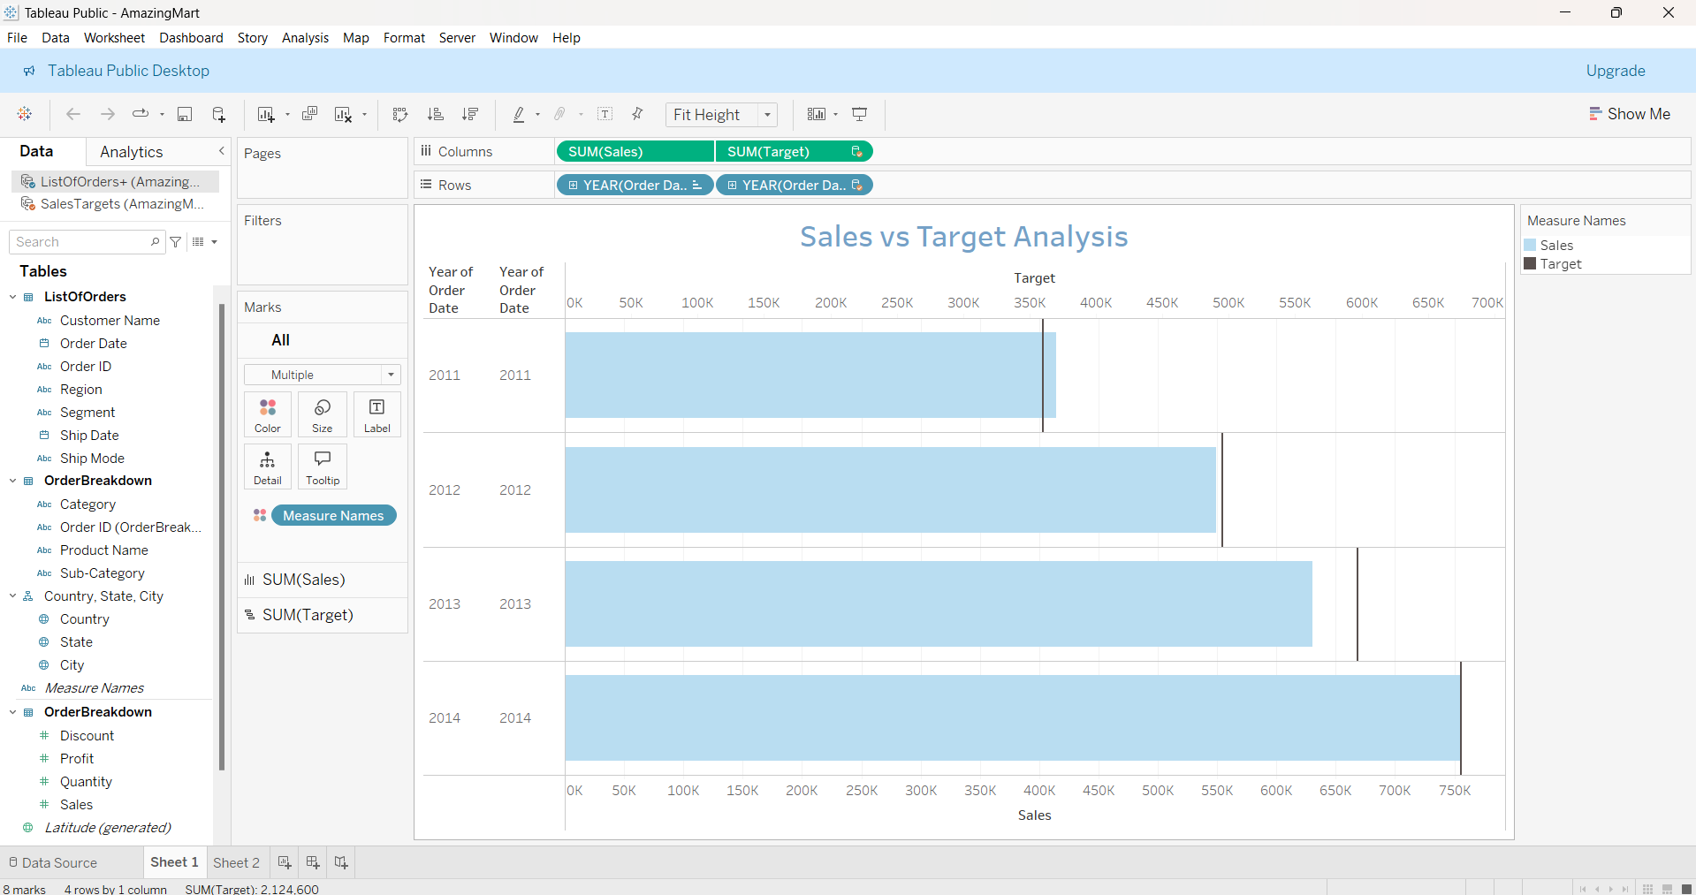

Slide 31
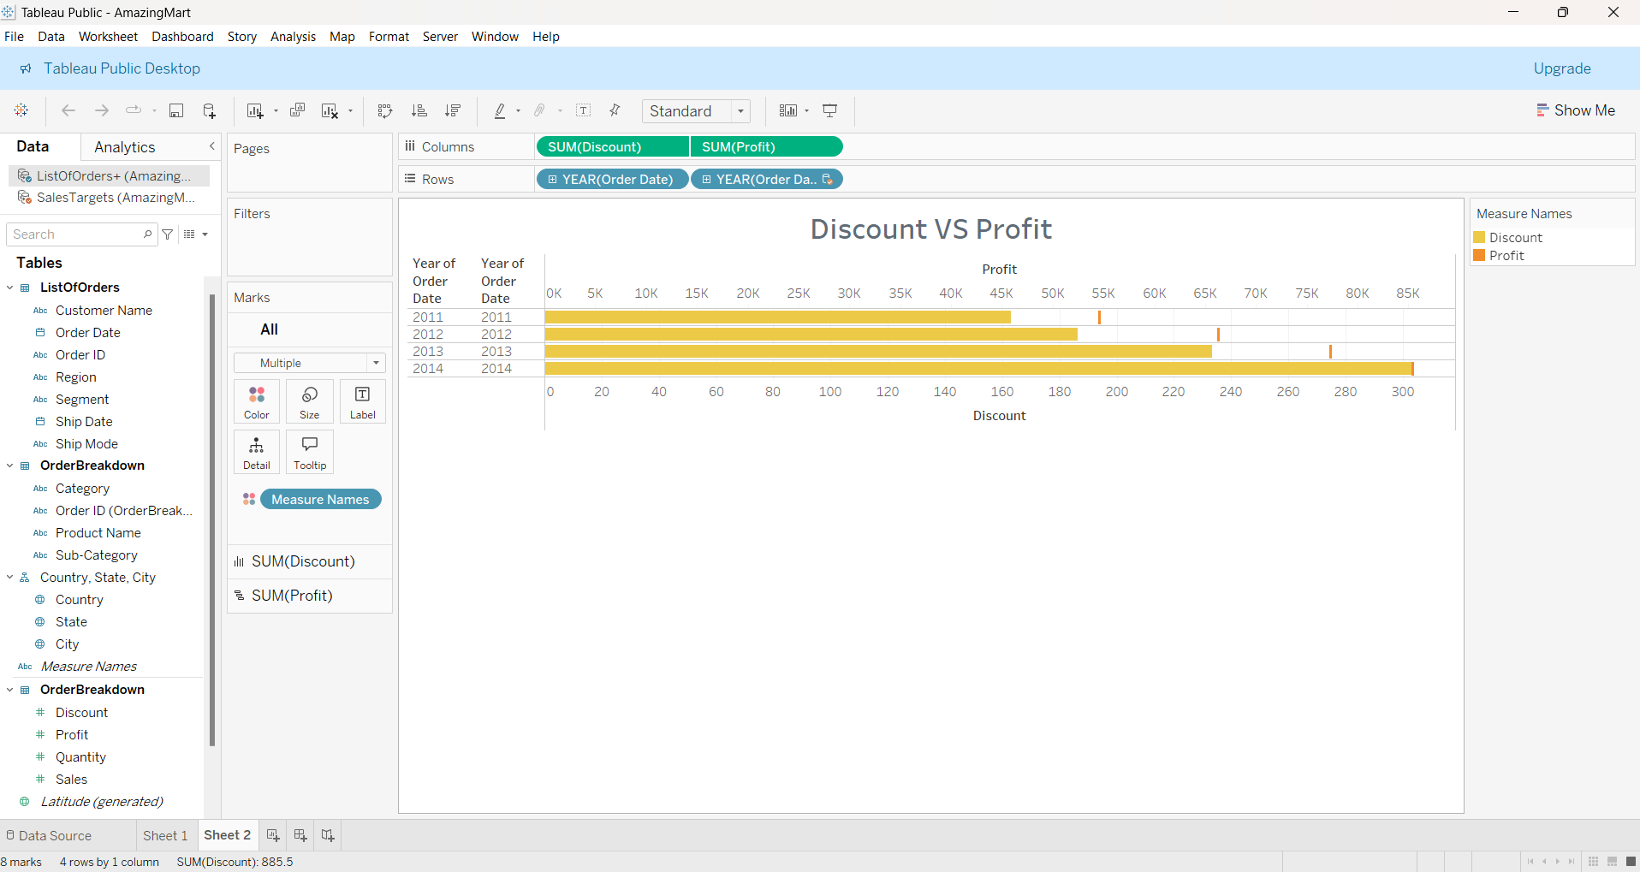

Slide 32
Conclusion :
Our sales analysis has revealed critical insights that will drive strategic improvements and growth. We identified peak sales periods and customer preferences, enabling better inventory and marketing planning. Analyzing product performance highlighted best-sellers and underperformers, aiding in optimized inventory management and targeted promotions.
Regional sales analysis pinpointed high-potential markets and areas needing attention. Evaluating shipping methods and delivery times ensures efficient logistics and improved customer satisfaction. Insights into pricing strategies and discount impacts help maximize profit margins.
Strategic implications include enhanced marketing campaigns, better stock management, improved logistics, and refined pricing strategies. These insights enable informed decisions that drive business growth, enhance customer satisfaction, and increase profitability. Thank you for your attention, and we look forward to implementing these strategies for continued success.

Slide 33

Thank you

